Slide 1

INTRODUCTORY LECTURE

Slide 2

CAP776
PROGRAMMING IN PYTHON
The Kick Start Session

Slide 3
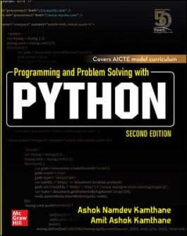
Course details
LTP – 3 0 2 [3-Lecture,2-Practical/week]
Text Book
PROGRAMMING AND
PROBLEM SOLVING
WITH PYTHON by
ASHOK NAMDEV KAMTHANE AND
AMIT ASHOK KAMTHANE,
Tata McGraw Hill, India
https://www.mheducation.co.in/programming-and-problem-solving-with-python-9789390113026-india

Slide 4
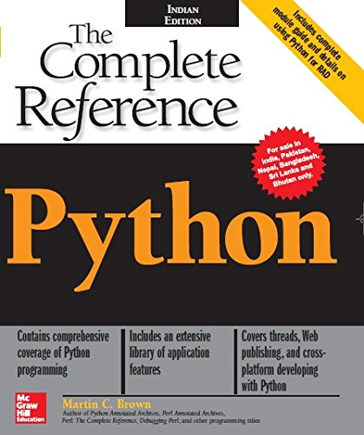
References:
THE COMPLETE REFERENCE by MARTIN C. BROWN, MC GRAW HILL

Slide 5
Course Assessment Model
Marks break up
Attendance 5
Continuous Assessment(3 out of 4) 25
MTT 20
ETT 50
Total 100

Slide 6
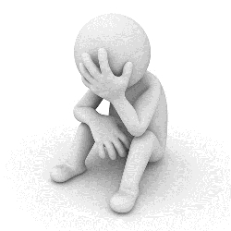
The hitch…
Three BURNING questions in mind…
Why we are learning Python?
What would we do with it?
What will the course outcome?

Slide 7
Course Outcomes:
define the basic structure and features of Python programming
understand the working of object-oriented programming concepts like encapsulation, inheritance and polymorphism
apply pandas and NumPy libraries for data analysis and visualize results using matplotlib and seaborn
analyze the situation specific problems and perceive solutions

Slide 8
Learnings for you…?
Desktop applications (Tkinter library, toolkits such as the wxWidgets, Kivy, PYQT)
Web applications(frameworks are Django, Flask, Pyramid) web-framework named Django is used on Instagram
Machine Learning and Artificial Intelligence
(Library: Pandas, Scikit-Learn, NumPy)
Data Science and Data Visualization
( Matplotlib, Seaborn)
Enterprise Applications (Odoo, Tryton)
Scientific and Numeric (SciPy, Pandas, Numpy)

Slide 9
Python used in top industry like:
Google
Facebook
Instagram
Spotify
Netflix
Dropbox
Reddit

Slide 10
Python Job Profiles
Software Engineer
Python Developer
Research Analyst
Data Analyst
Data Scientist
Software Developer

Slide 11
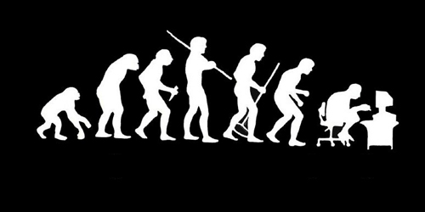
Let us re-invent ourselves
To begin with basics…
Let us go to basics.
Let us begin from toddling to learn to walk
Get ready to be childish….

Slide 12
Daily routine
Let us look around our daily routine…
Let us see where all we do programming everyday
Simple things we do to start the day

Slide 13
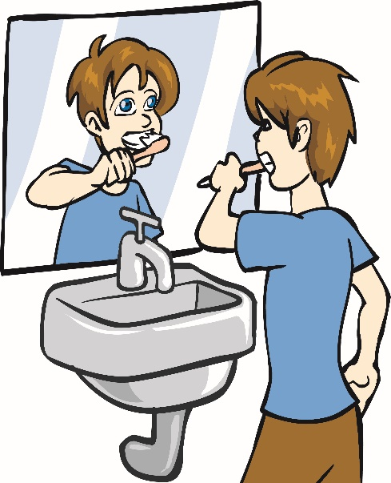
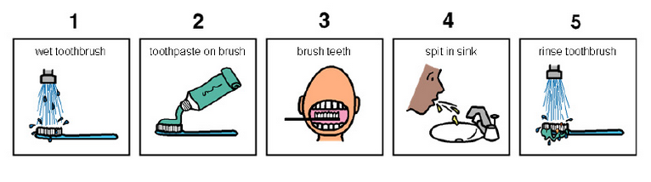
So there is ONE program you know which is there in you…

Slide 14
Daily routine
Start
There is a set procedure
Each step is defined
The occurrence is ordered
Jump is NOT permitted
A step cannot be skipped
Pick Brush
Rinse Brush
Apply Paste
Brush
Rinse Mouth
Rinse Brush
Stop

Slide 15

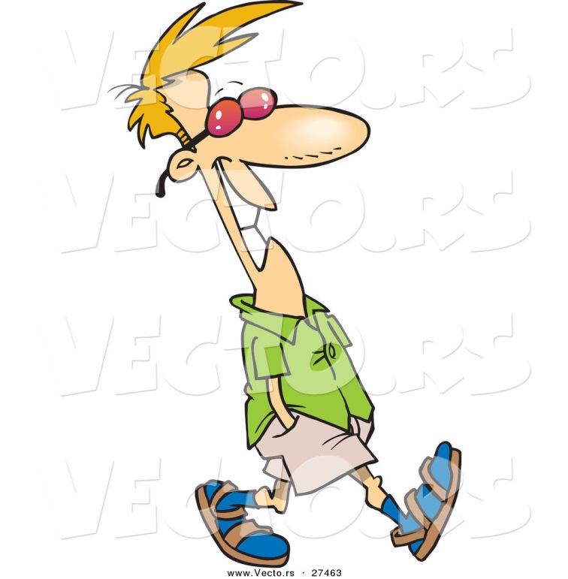
Daily routine
Let us explore more as the day goes by…
Going for a morning 0900 AM Class
Going for a movie at 0900 AM
It is all about WHICH program is loaded WHEN

Slide 16


Daily routine
The flow changes
Start
Go!!!
Where
To
Go?
Class
Movie
Stop
Stop

Slide 17

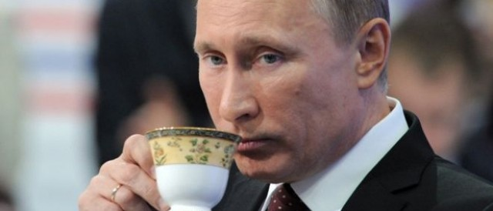




Daily routine
Yet another example but more complex
Vision
Sensor
Sipping TEA
Smell
Sensor
Radiation
Sensor
If all sensors
SIP
If even one is
Touch
Sensor
WAIT!!!

Slide 18





So what does this mean?
Take ANY activity of the day…
It will have a set procedure
It has to be done in a designated way
If not done the specified way will yield wrong results.
Success in doing it depends on how closer one is to the prescribed method.
This clearly shows that everything has a

Slide 19

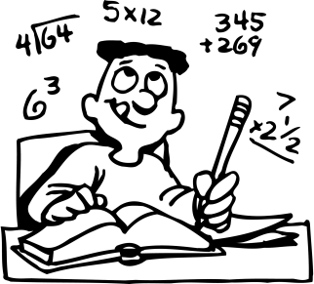
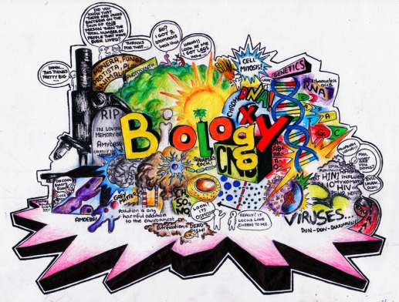
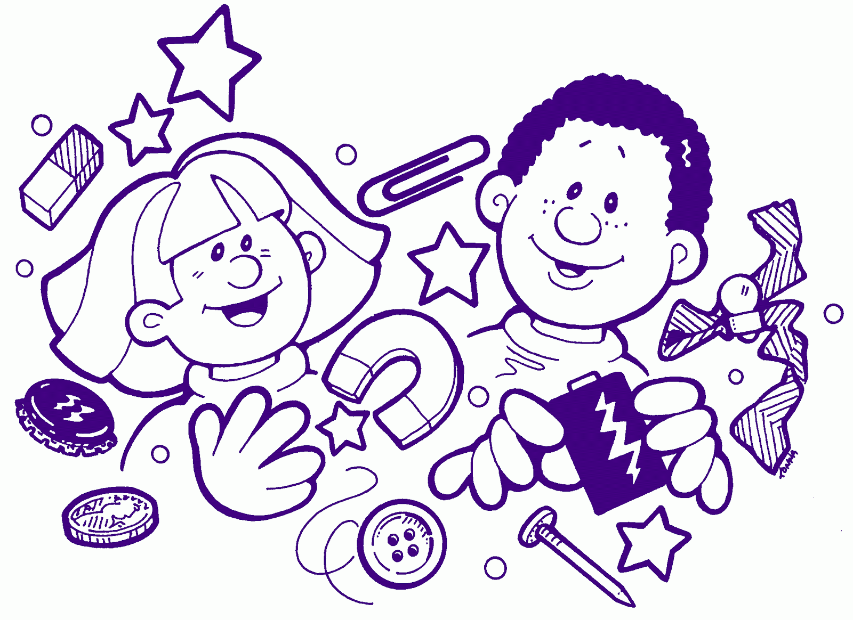

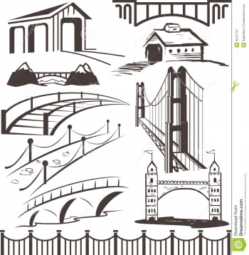

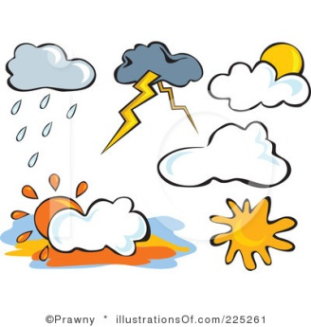
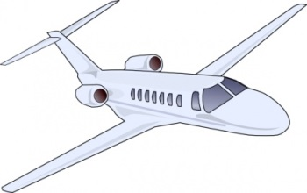
Logic, logic and logic

Slide 20
What next?
If there is logic in anything and everything
There has to be ways to represent logic
There has to be modes to modify and re-represent logic.
There should be methodology to implement and re-design logic.
And for all this…

Slide 21
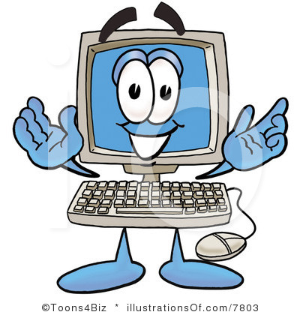

What next?
There has to be logic machine to assimilate, understand, solve, store, retrieve and represent logic
There has to be a LANGUAGE to communicate with the logic machine
Otherwise….

Slide 22



Diving deeper…
How do I get A+ grade in CAP776?

Slide 23


Diving deeper…
How do I get A+ grade in CAP776?
If marks are greater than or equal to 85.
A program written in Java language with LOGIC

Slide 24
The course contents:
Python basic
OOP concepts
Introduction to NumPy
Handling data with pandas
Data visualization
Machine learning

Slide 25
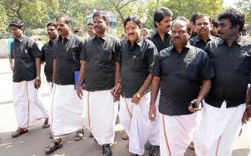


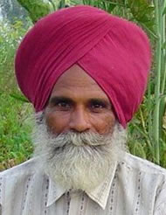

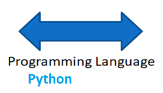
What do we need to know?
Unit 1
Tamil
Punjabi
Need of Language :: Python basic

Slide 26
What do we need to know?
Unit 1
data types and operators
How to do calculations
Area = Length * Breadth
Area = 12 * 5
Area = 10 * 4
Area = 7.6 * 3.7
3.7
4
7.6
5
10
12

Slide 27
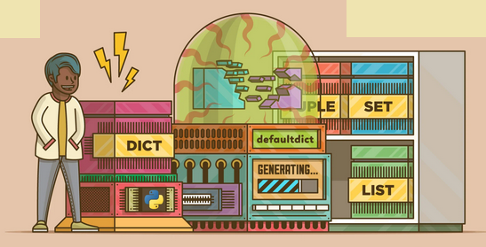
What do we need to know?
Unit 1

Slide 28
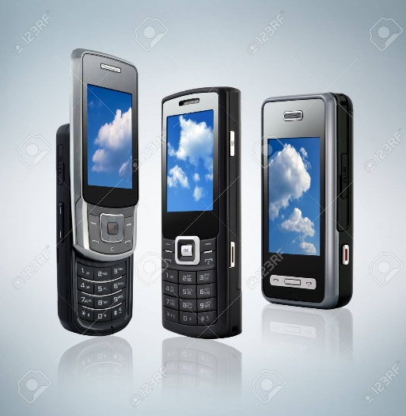
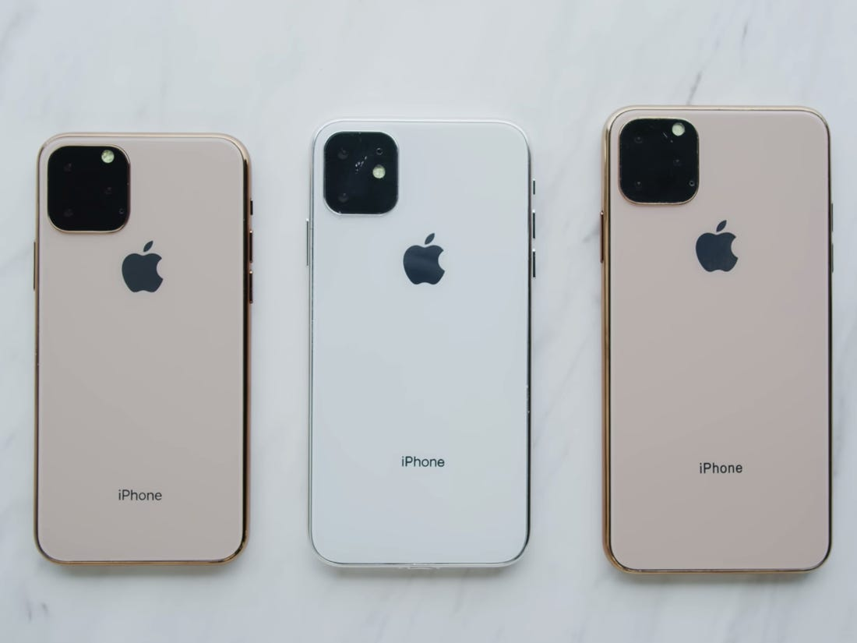
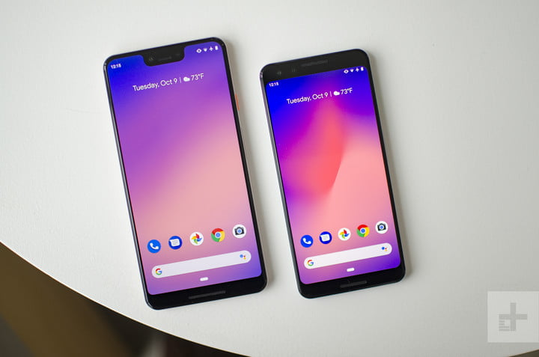
What do we need to know?
Unit 2
OOP concepts: class and object
Mobile
Symbian
(Keypad
Phone)
Android
phone
i-phone

Slide 29



What do we need to know?
Unit 2
Inheritance: reusability
father
mother
child

Slide 30
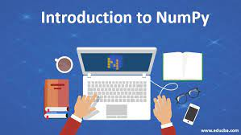
What do we need to know?
Unit 3

Slide 31
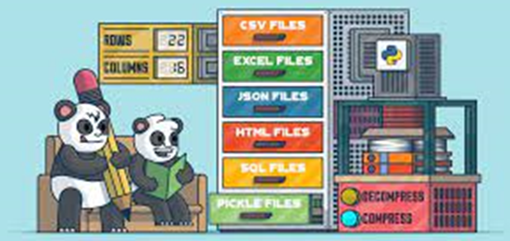
What do we need to know?
Unit 4
Handling data with pandas

Slide 32
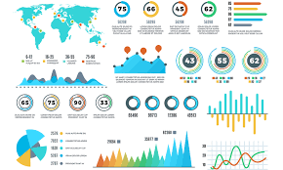
What do we need to know?
Unit 5
Data visualization

Slide 33
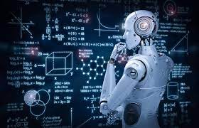
What do we need to know?
Unit 6
Machine learning

Slide 34
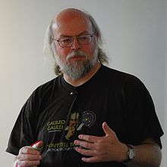
Recognize?
A. Dennis Ritchie
B. Bjarne Stroustrup
C. James Gosling
D. None

Slide 35
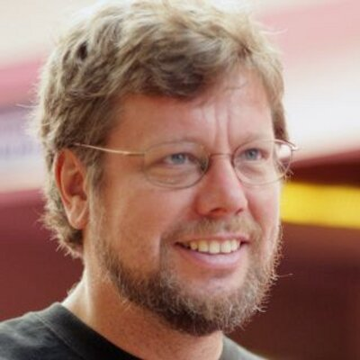
Recognize?

Slide 36
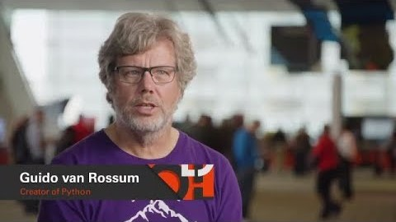
Who developed?
Python was developed in 1989 by Guido Van Rossum

Slide 37
Which is OOPs feature?
Encapsulation
Polymorphism
Inheritance
Above All

Slide 38

Acknowledgements
NPTEL(National Programme on Technology Enhanced Learning)
Simplilearn
Coursera
edureka

Slide 39

Next :Basics in Python

